Slide 1
5
MUHAMAD DANI SETIAWAN
Mitigation DDoS
KAPTEN BINTANG

Slide 2
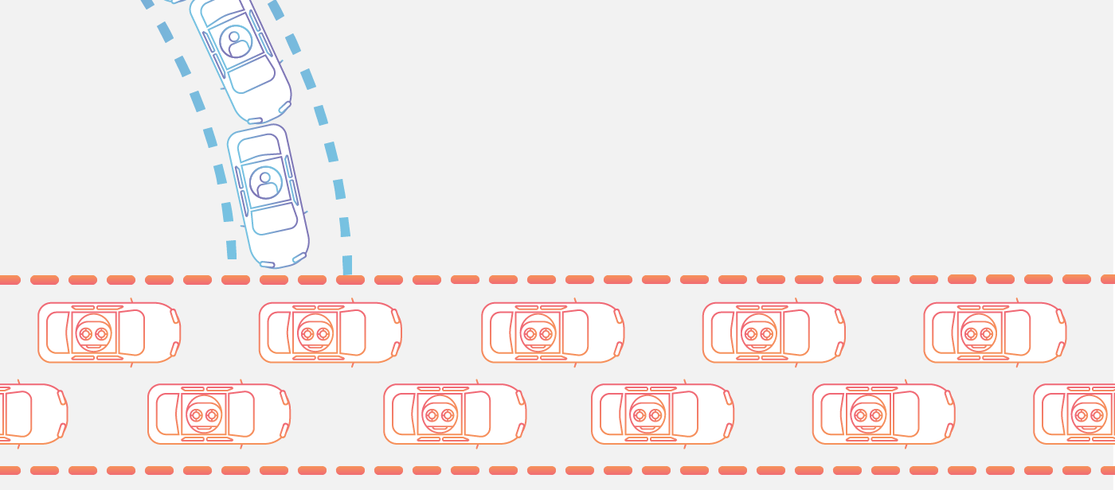
CYBER SECURITY
Cybersecurity is the protection of internet-connected systems, including hardware, software and data, from cyberattacks.
EXPLANATION DDOS
WEB THREAT
Web based threats is malware programs that can target when user using the Internet.
These browser based threats include a range of malicious software programs that are designed to infect victims’ computer

Slide 3
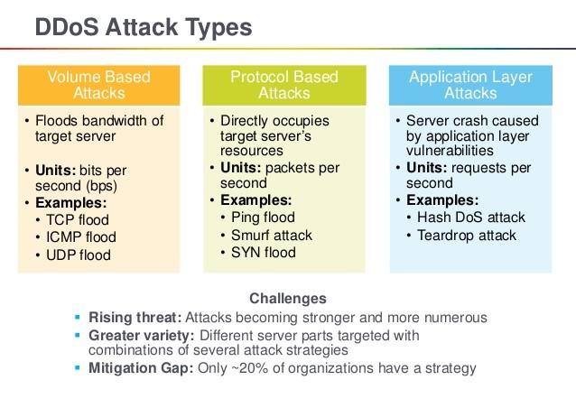

Slide 4
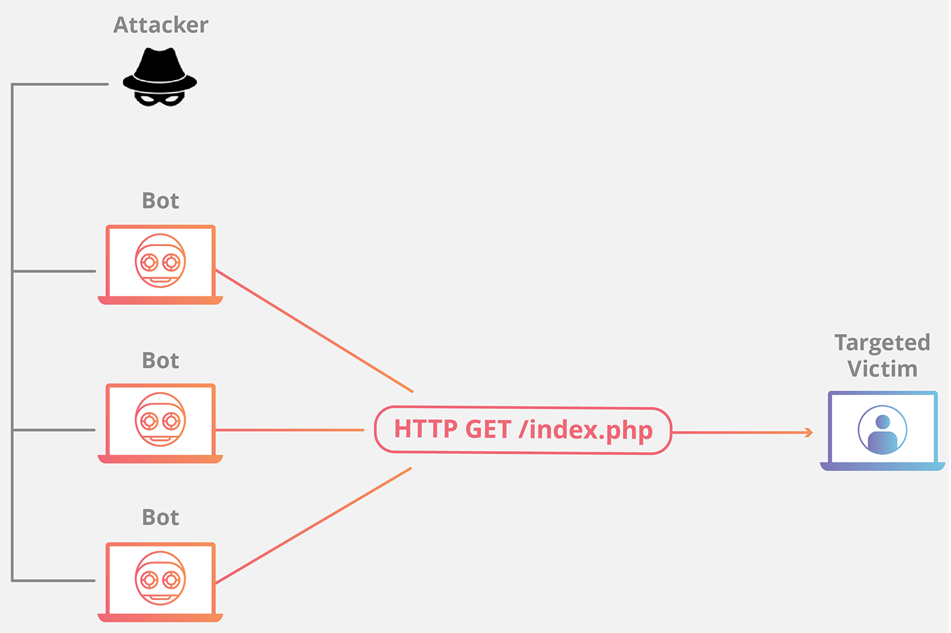
APPLICATION LAYER ATTACKS
The goal of these attacks is to exhaust the resources of the target in layer where web pages are generated on the server and are delivered in response to HTTP requests.

Slide 5
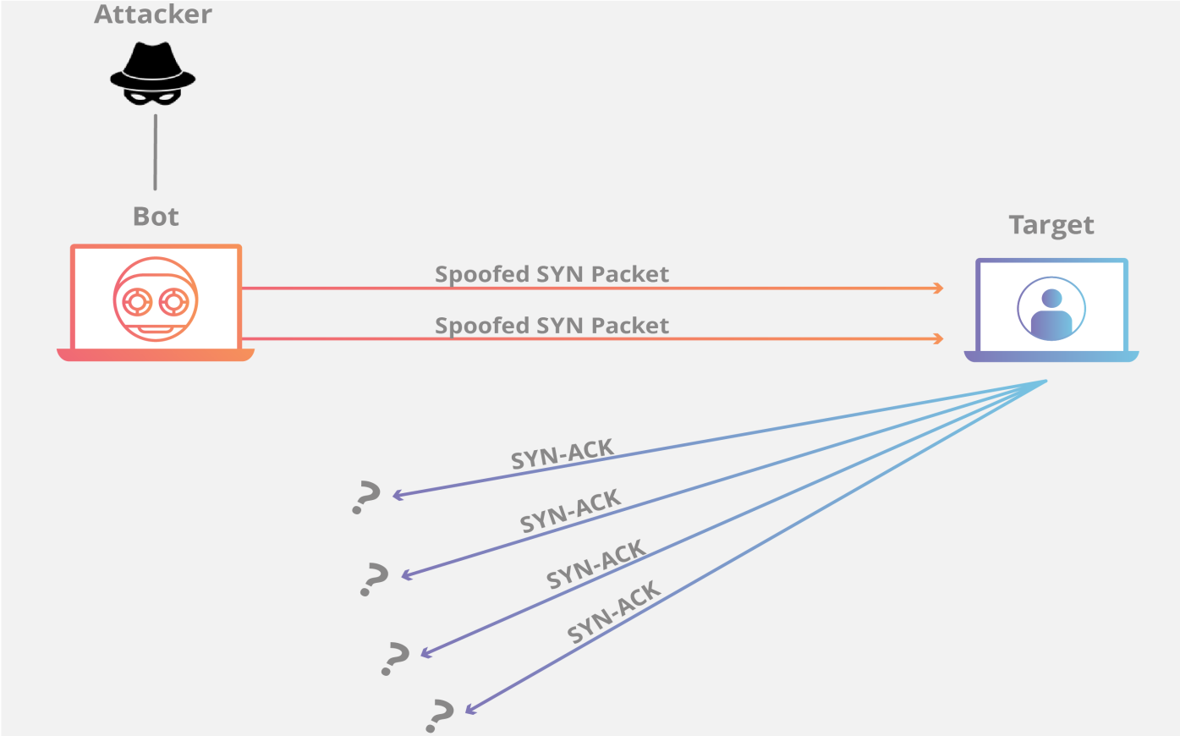
SYN Flood
SYN Flood it’s a kind of protocol attacks category and then if analogous to the SYN flood is a worker in a supply room receiving requests from the front of the store. The worker receives a request, goes and gets the package, and waits for confirmation before bringing the package out front. This attack exploits the TCP handshake by sending a target a large number of TCP “Initial Connection Request” SYN packets with spoofed source IP addresses.

Slide 6
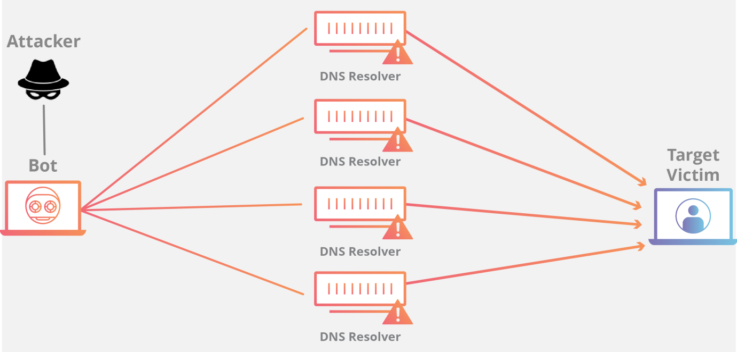
DNS Amplification
By making a request to an open DNS server with a spoofed IP address (the real IP address of the target), the target IP address then receives a response from the server. The attacker structures the request such that the DNS server responds to the target with a large amount of data. As a result, the target receives an amplification of the attacker’s initial query.

Slide 7
Explanation of DDoS Mitigation

Slide 8
WAF (Web Application Firewall)
Method DDoS Mitigation
-An integrated solution to protect all your apps, everywhere.

Slide 9
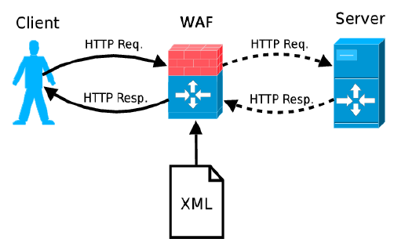
Architecture WAF

Slide 10
Conclusion
How to Prevent DDoS Attacks
-Buy Unlimited Bandwith
-Using the web application protection
-Maintaining the server
-Always be prepared for denial of service attacks
-Adapting the attacker pattern

